Slide 1
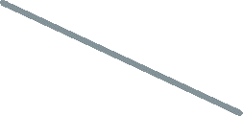
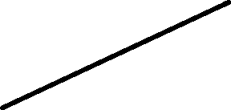
Multiple Linear Regression
Y
X₁
Involve more independent variables for prediction
X₂

Slide 2
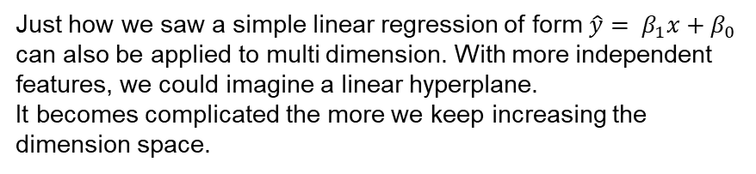



Linear Regression
Just how we saw a simple linear regression of form $\hat{y}= β_{1}x+β_{0}$
can also be applied to multi dimension. With more independent features, we could imagine a linear hyperplane.
It becomes complicated the more we keep increasing the dimension space.
Dependent feature
$$β_{1}$$
$$β_{0}$$
Independent feature

Slide 3
Plane of best fit
The intuition of best fit remains same, we would still be looking at the sum of squared errors to determine which plane can explain the model in the better way.
Inclusion of more features need not necessarily converge to optimal model. Always look at the simplest model which can explain most variation of dependent feature.
One way of doing this could be going with step-wise selection approach. We could apply forward selection, backward elimination or bidirectional elimination.
This could be tedious process to follow and can be achieved in simpler ways too.
Dependent feature
Independent feature

Slide 4
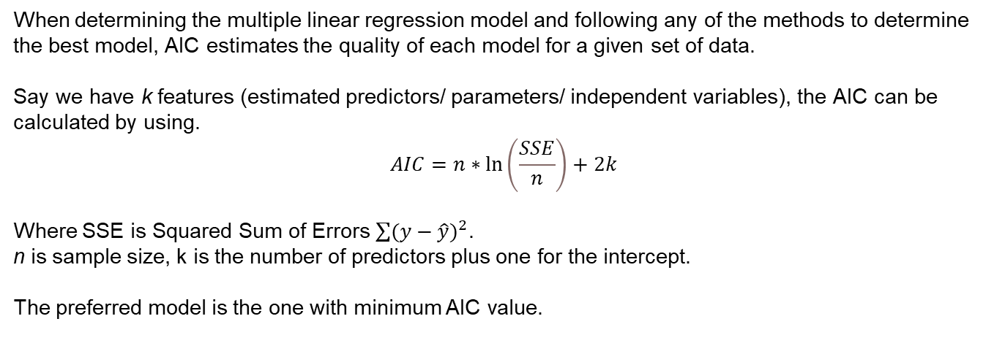
Akaike Information Criterion
When determining the multiple linear regression model and following any of the methods to determine the best model, AIC estimates the quality of each model for a given set of data.
Say we have k features (estimated predictors/ parameters/ independent variables), the AIC can be calculated by using.
$$AIC=n∗\ln\left(\frac{SSE}{n}\right)+2k$$
Where SSE is Squared Sum of Errors $\sum{{(y−\hat{y})}^{2}}$.
n is sample size, k is the number of predictors plus one for the intercept.
The preferred model is the one with minimum AIC value.

Slide 5


Multicollinearity
Multicollinearity is when two or more independent features in regression model are highly correlated/strongly related. This complicates the process of determining the individual effects of each independent feature.
When dealing with effect of a variable in the model, change in one of the predictor should only change the outcome (target variable) but not have an effect on other predictors.
When the multicollinearity if observed in the data, the coefficients from OLS becomes unstable/unreliable.
Checking collinearity is simple in Pandas. (df.corr())
What to do when we observe multicollinearity and how to deal with it?

Slide 6
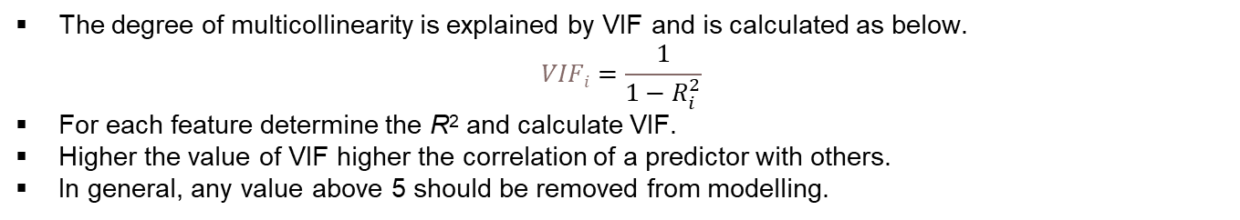
Variance Inflation Factor
The degree of multicollinearity is explained by VIF and is calculated as below.
$$VIFi=\frac{1}{1−R_{i}^{2}}$$
For each feature determine the R² and calculate VIF.
Higher the value of VIF higher the correlation of a predictor with others.
In general, any value above 5 should be removed from modelling.

Slide 7
Other options?
When there are 2 features correlating with each other, we could eliminate one of them and observe the model effectiveness.
Say x₁ and X₂ are highly correlated, build the model just with x₁ or x₂
Principal component Analysis can also be applied. PCA is unsupervised dimensionality reduction technique.

